Slide 1

deepthi
Prasannjit kumar
prasaanth
Ravi kodali
Sasank krishna
Shivam patil
Sruja aluri
Sravani burela

Slide 2
Presenters
Sruja Aluri
Sravani Burela
Ravi Kodali
Shivam Patil

Slide 3
Agenda
Brief Recap
Demonstration
System Testing
User Testing
Future Goals

Slide 4
Recap
What is MyTab.org?
Requirements
System design
Program Design
Security

Slide 5
What is MyTab.org?
Single safe platform to hold multiple accounts of a user and enable accessing these accounts with just one click
Target – Large organizations that use multiple accounts
Current prototype version target – Cornell University

Slide 6
Requirements
Register - Create a master account for MyTab
Login - Login to MyTab account
Add account – Add an account to MyTab by providing the account’s credentials
Access account – Access an added account
Edit account – Change the account credentials of the added accounts
Delete account – Remove the account from MyTab
Logout of an accessed account – Close the accessed account
Logout – Safely logout of MyTab and any open accounts

Slide 7
System Design
3 Tier Architecture

Slide 8
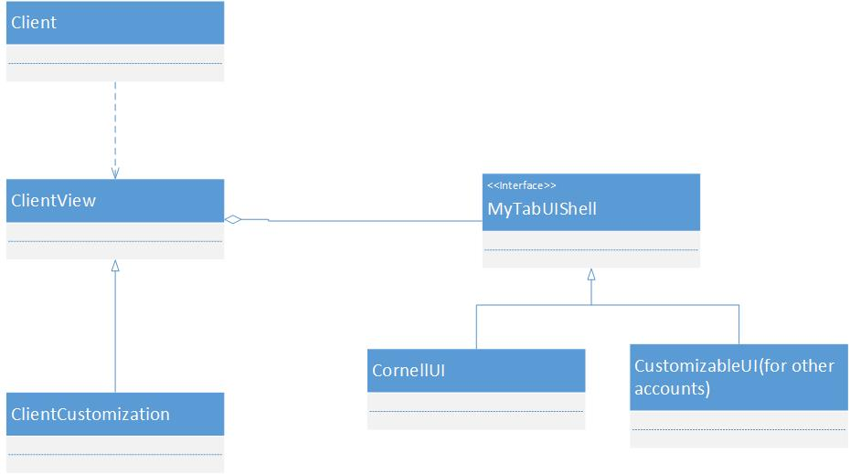
Program Design
Bridge Design Pattern

Slide 9
Security
HTTPS protocol and SSL encryption used for all data transmission
User provided information encrypted before stored
AES encryption standards used
Secure application code

Slide 10
Progress from last milestone
Functionality Complete – Edit/Delete, Validations
Inclusion of Usage policy
System Testing
User Testing
Improved Security

Slide 11
Demonstration https://mytab.org/

Slide 12
System Testing
Master test plan documented
120 test cases executed
Tested in multiple phases

Slide 13
System Testing Results
First phase – 35 bugs encountered
Second phase – 11 bugs encountered
Current Status – 2 failing test cases (bugs)
Blackboard issue
Edit/Delete icons

Slide 14
User Testing
Beta version of MyTab.org tested
Test Objectives
To test the user interface of the systems for any errors and usability issues.
To check the working of the functionality of the system like creating a MyTab account, logging into the system, adding new accounts, accessing the added accounts and editing/deleting the added accounts.

Slide 15
User Testing Contd…
Participants
Process
Survey questions
Troubleshooting

Slide 16
User Testing Results
72% of the users rated a pleasant overall experience
68% of the users rated a pleasant experience with the navigability in the website
59% of the users rated an excellent design and colors of the website
Other comments:
Users have responded that they like the idea of using multiple Cornell accounts from a single site
Users responded that the website should have been a little easy to use

Slide 17
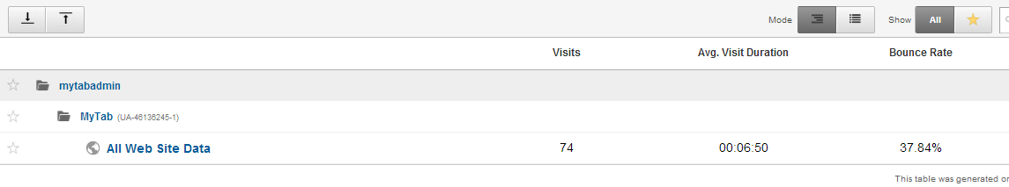
Analytics

Slide 18
Future Goals
Acceptance Testing
Project Delivery

Slide 19
Acceptance Testing
Client Acceptance testing
Will run all the scenarios planned on the final system

Slide 20
Project Delivery
Source Code
Test plans
Test reports
Documentation
Web application

Slide 21
Documentation
Requirements (updated to the final system)
System and Program design (updated to the final system)
User manual
Presentation slides
License document

Slide 22
Conclusion
The documentation and the entire project delivery will help make the future maintenance of the application easy

Slide 23
Questions?

Slide 24
Thank You

